Slide 1
Public-Private Partnership for Mixed-Use Hotel and Entertainment District Adjacent to Neyland Stadium
  SBC NUMBER: 540/009-18-2023
  Pre-Proposal Conference and Site Tour
  January 2024

Slide 2
Today’s Itinerary
RFP Conference
Presentation: The Neyland Entertainment District P3
  1:30-2:00 pm (30 minutes)
Q&A Session
  2:00-2:20 pm (20 minutes)
Intermission
  2:20-2:30 pm (10 minutes)
Depart for Site Tour, Load
  2:30 pm (60 minutes)

Slide 3
Agenda
RFP Conference
01 | Introductions
02 | Project Concept and Success Criteria
03 | Project Opportunity
04 | RFP Process
05 | Q&A
06 | Site Tour

Slide 4
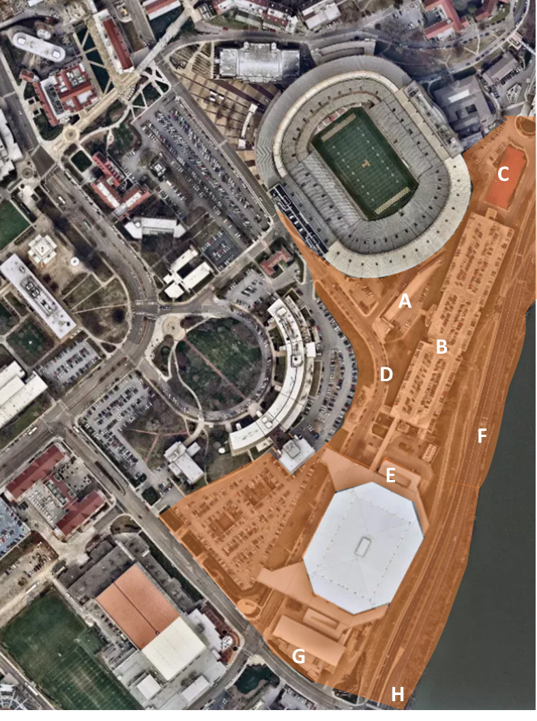
Project Concept Overview
Neyland entertainment district
Create a one-of-a-kind transformative entertainment district
Anchor the district with a boutique, full-service “condotel”
Envisioned to support and enhance gamedays and “everyday” experience with a year-round asset
(A) Stadium Plaza; (B) G10 Deck; (C) Hotel/Condo; (D) Fulmer Dr. Pedestrian Improvements; (E) Food City Center Amenity; (F) Neyland Dr. Improvements; (G) Bike/Ped Bridge Landing, (H) Neyland Drive/Lake Loudoun Pedestrian Improvements

Slide 5
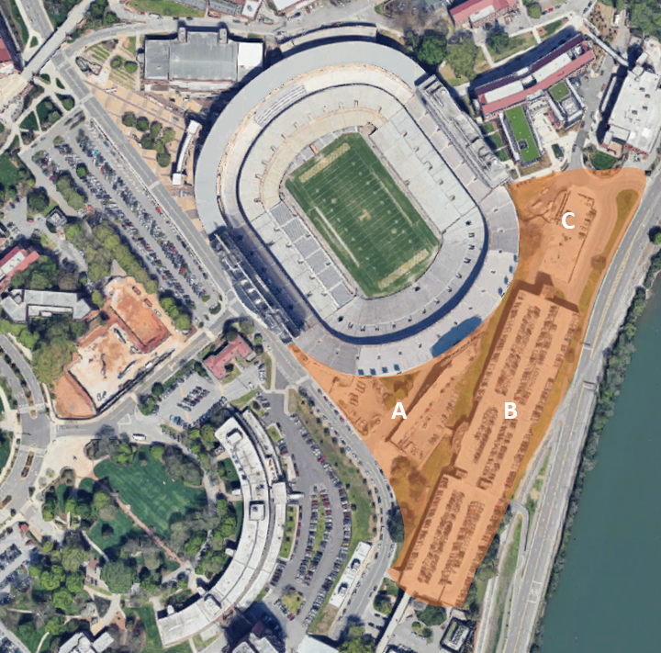
Initial Phase Overview
Neyland entertainment district
“Condotel” that uniquely brands the rich history and traditions of the University, UT Athletics, and historic Neyland Stadium
High-end, luxury hospitality accommodations serving UTK alumni, fans, and Knoxville visitors
G10 Parking Deck
Street Plaza and Greenspace that initiates an attractive place for people to gather on gamedays and non-event days
(A) Stadium Plaza; (B) G10 Parking Deck, (C) Hotel/Condo

Slide 6
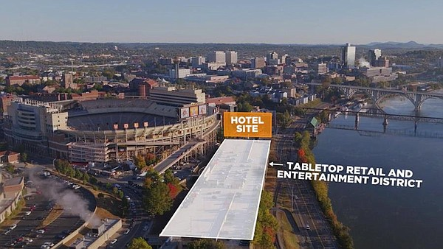
Key Changes: RFI to RFP
Neyland entertainment distriCT
RFI Concept Image
Since the RFI release, the RFP reflects an evolved Project Concept that:
Expands footprint beyond the G10 deck and hotel site
Includes more detailed security and circulation design objectives
Contemplates a multiphase development to accomplish UTK’s strategic goals
RFP Concept Image

Slide 7
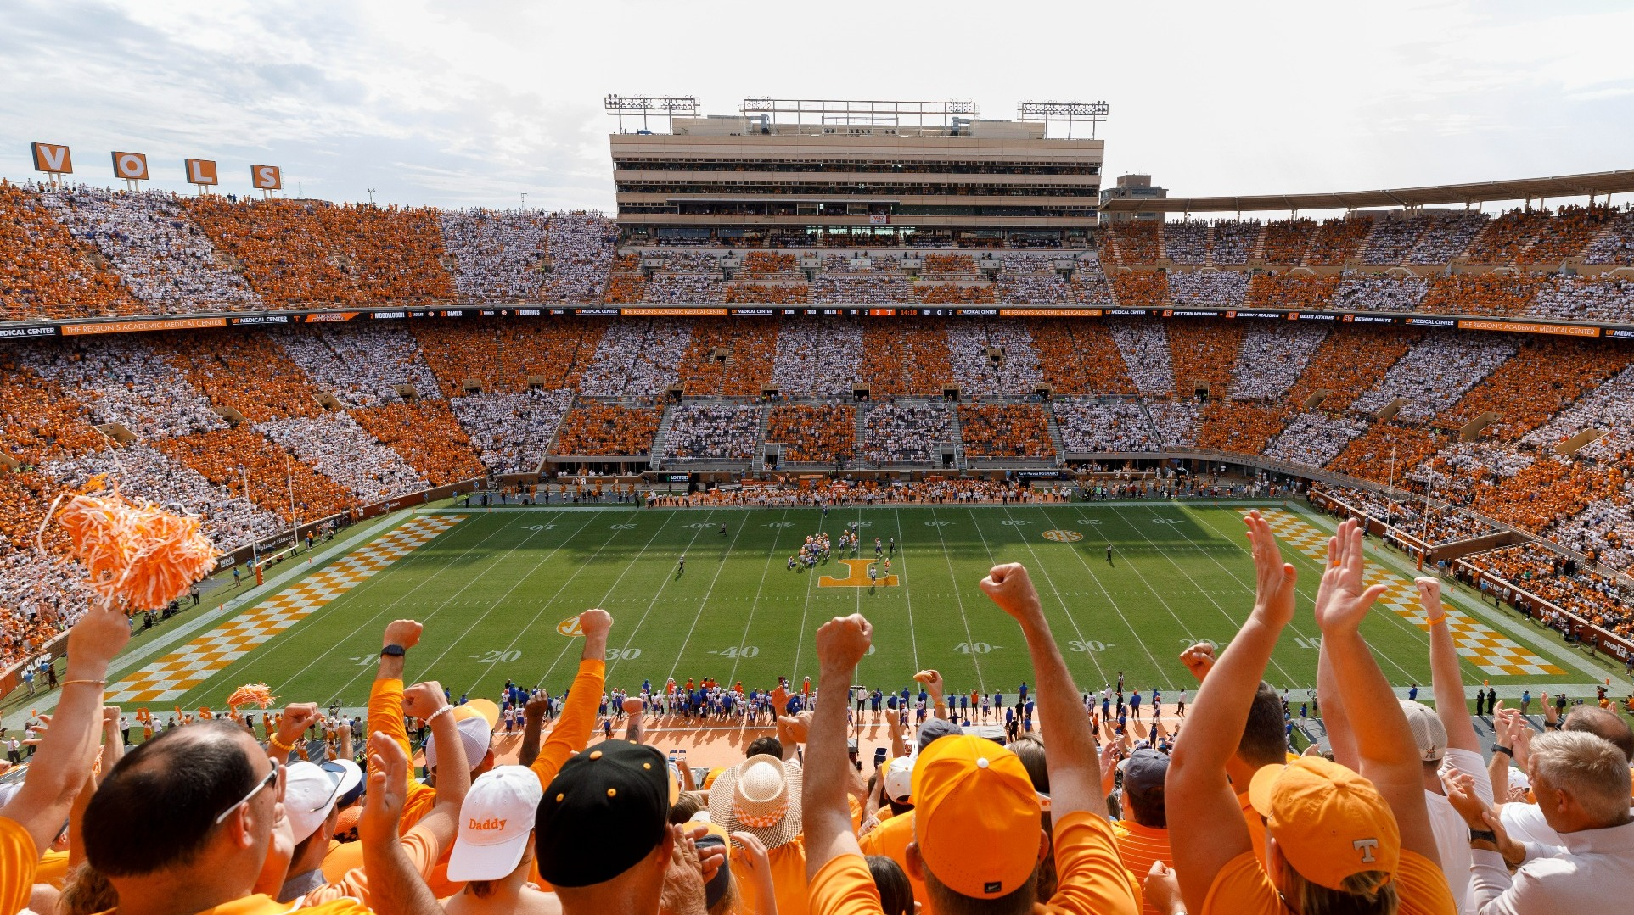
Success Criteria
Neyland entertainment district
Strategic Goals:
Enable UTK to deepen its connection with important constituencies
  Students
  Fans
  Alumni & Donors
  Knoxville and the Region
Perform financially and generate return to University
Enhance the gameday experience
Elevate UTK’s campus aesthetic and assist in riverfront placemaking and connectivity

Slide 8
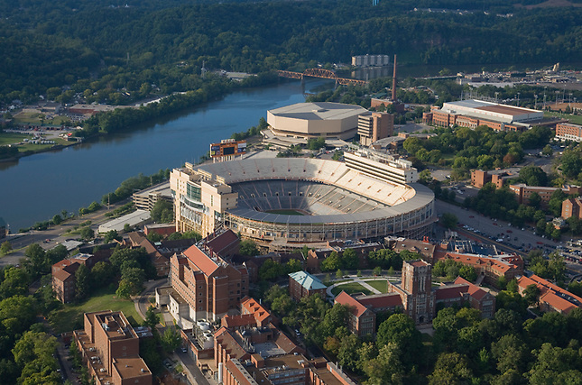
Success Criteria
Neyland entertainment district
Physical Manifestation:
Establish a gathering place for campus and the community
Thoughtfully engage the adjacent Tennessee River waterfront
Develop a stronger connection with the rest of campus, including the Food City Center
Create a stronger sense of arrival on the south side of Neyland Stadium
Improve the exterior aesthetics on the south side of Neyland Stadium

Slide 9
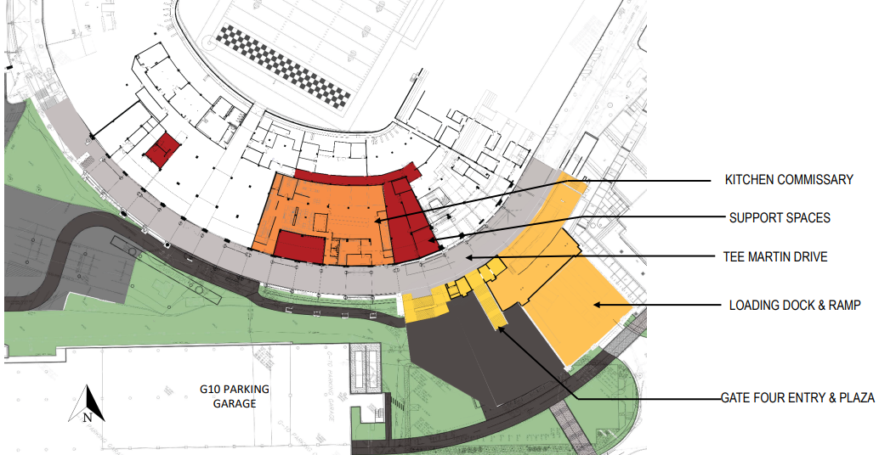
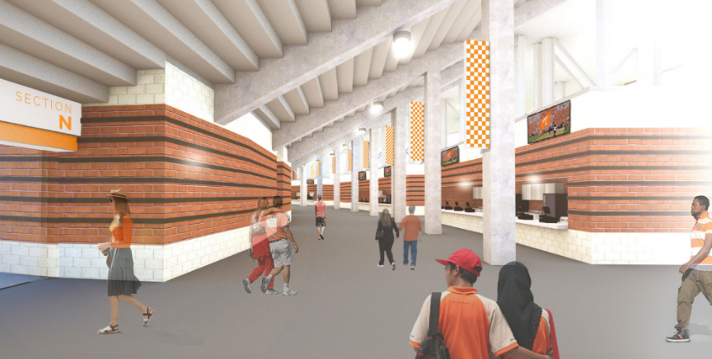
Success Criteria
Neyland entertainment district
Project should complement UTK investments in revolutionizing the stadium experience for students, fans, faculty, staff, visitors, and the extended Vol community.
Fall 2023 | Fall 2024 | Fall 2025
Removal of South Stadium Hall with structural strengthening of the stadium's south end Partially completed Wi-Fi capabilities Brick cladding around in-bowl vomitories New restrooms under the Gate 10 ramp Extended footprint for Truly's Tailgate, giving fans in the south endzone an expanded concourse | Stadium-wide Wi-Fi connectivity Stadium kitchen, commissary and loading dock New southeast elevators vertically connecting all concourses New Gate 4 entry plaza Renovations and upgrades complete for all stadium skyboxes Initial construction for the westside Founders Suites | Expand south concourse 1 (increase restrooms, enhance concessions, widen concourse) Complete Founders Suites Tee Martin Drive to shift south of the Gate 10 ramp
FALL 2023

Slide 10





Initial Phase Program Overview
Neyland entertainment district
 | Use | Scale | Concept
 | Hospitality | Approximately 250 keys | Upper-scale or luxury accommodation serving the UTK community
 | Condominium | Minimum 30 units | Highly amenitized “condotel” living opportunity unique in higher education, that will enhance connection between UTK and its community.
 | Retail and Entertainment | Minimum 15,000 SF | Destination concepts that will enhance the District atmosphere and serve the campus and broader communities
 | Plaza / Greenspace | Varying Scale | Greenspace and streetscaping that create attractive places for people to gather on gamedays and non-event days.
 | Parking | Varying Scale *Net-Neutral Requirement | Parking will be used to provide spaces for vehicles and will service general campus use, gameday use, and the Neyland Entertainment District.

Slide 11
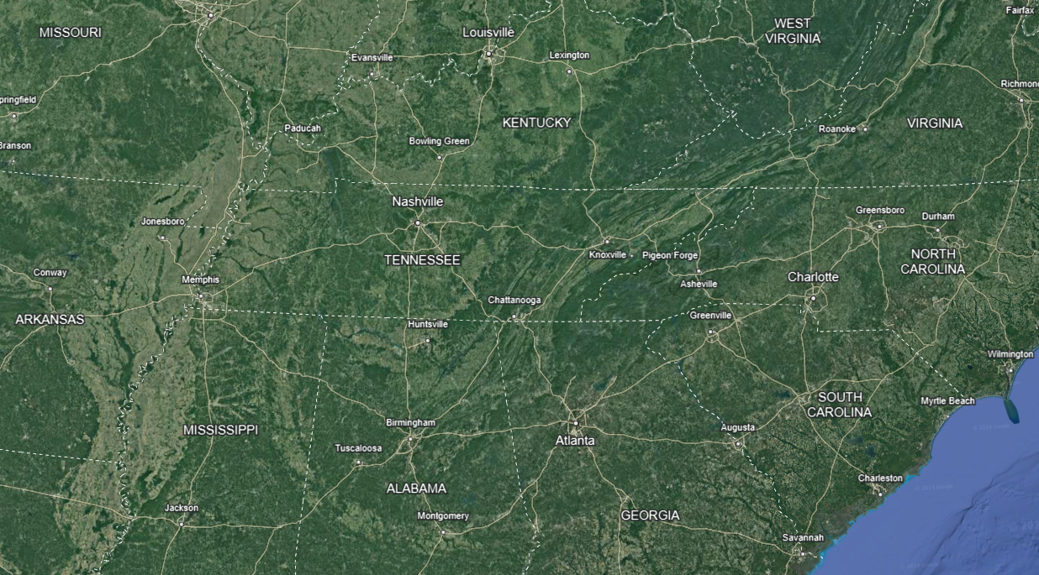
Knoxville Market Opportunity
~ 3-hour drive
~ 3-hour drive
~ 4-hour drive
~ 2-hour drive
~ 3.5-hour drive
11

Slide 12
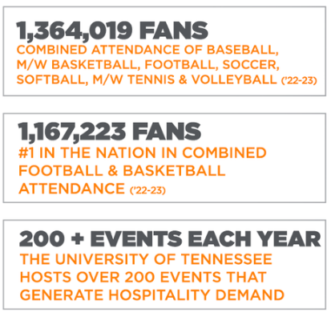
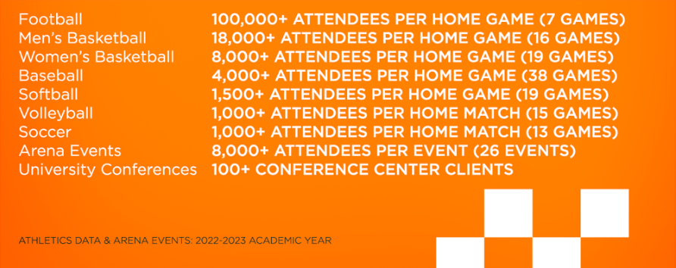
University-Driven Market Opportunity
Neyland entertainment district
Existing sports engagement creates an exciting opportunity to capture attendees and create a special gameday for all.

Slide 13
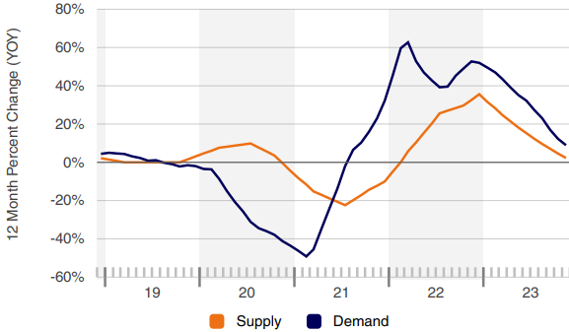
Market Context: Hotel
Neyland entertainment district
Hotel Market Opportunity:
Demand has outpaced supply for luxury hotels within the surrounding area, indicating opportunity for a new hospitality experience adjacent to Neyland
Knoxville Tourism Market
Luxury/Upper Upscale Hotel Market Shifts in Knoxville
Overnight Trips by Length of Stay
(Jan-Sept 2023)
January – September 2023
1,845,190+
Hotel Rooms Sold
3% Increase
From 2022
73,780+
Room Nights
74%
Occupancy
9% Increase
From 2022
31,000+
Bookings
Sources: Visit Knoxville / CoStar Realty

Slide 14
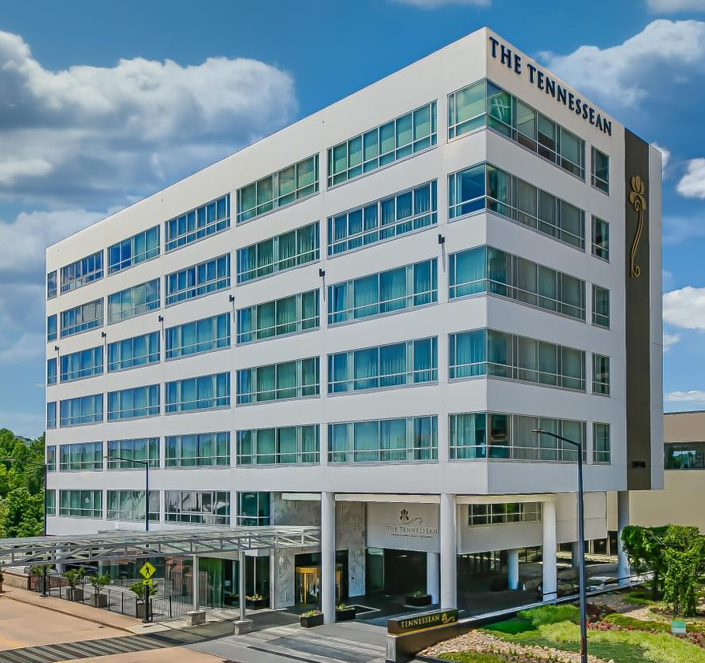
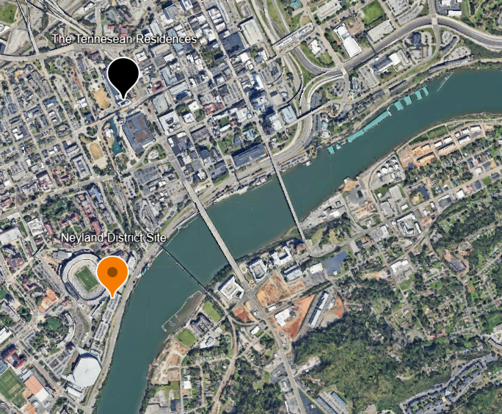
Market Context: Condo
Knoxville’s condo market has been driven by growth in high price point, luxury condo units delivered downtown.
Most Recent Condo Sales (in 2022)
Prices: $1-1.5M
Neyland entertainment district
Potential Condo Residents Include:
Recent Condo Comp: The Tennessean Residences
Sponsors
Alumni
Donors
The Tennessean Residences
Friends of the University
Neyland District Site
Source: CoStar & Zillow

Slide 15





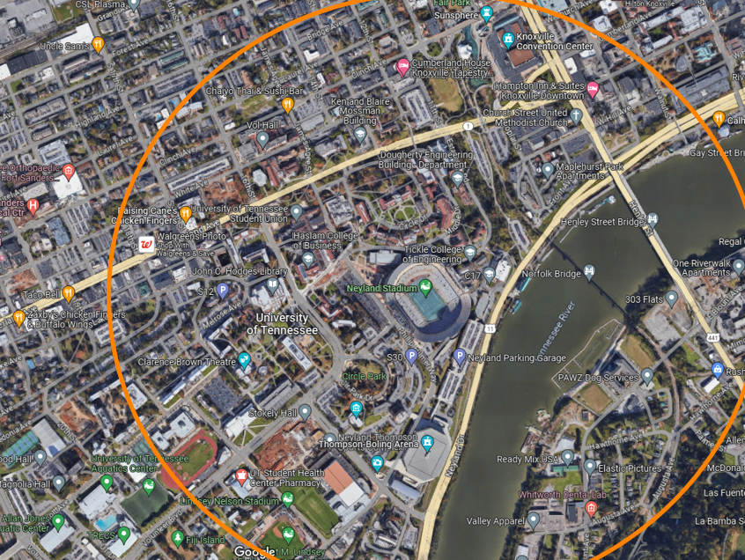


Market Context: Retail and Restaurants
Neyland entertainment district
Retail surrounding campus (3 miles) boasts healthy rents and low vacancy rates.
Limited restaurant options near the site create a compelling development opportunity.
OPEN
For Sale
$30
Restaurant Asking Rent PSF
4.4%
Restaurant space vacancy rate
2
Restaurants within a “walkable” distance of the stadium
(defined as ½ of a mile)
4.7%
YoY Increase in $/SF
1.5%
Knoxville General Vacancy Rate
½ mile from Neyland
$18.71
Asking Rent
PSF
15.4%
Cumulative Increase in Rent Over the Past 3 Years
Source: CoStar, Visit Knoxville

Slide 16
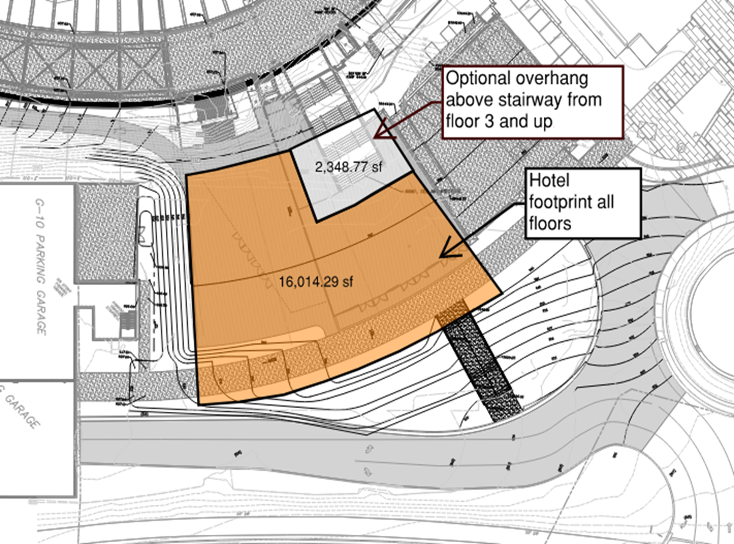
Site Assessment
Neyland entertainment district
The Project Site:
Allows for 16,000 SF floorplate
At 3rd story and above, optional expansion adds 2,500 SF per floor
The site can accommodate identified hotel and condo demand plus generous lobby, retail, food service, and other amenity spaces

Slide 17
Site Assessment
Neyland entertainment district
Site Considerations
Existing Conditions: Footprint should be positioned to maintain loading dock and access to loading dock.
Topography: Substantial grade differentials will require grading and possible retaining walls
Existing Utilities: Existing storm line (about 144’) and manholes will need to be relocated outside the building footprint. Underground storm detention will likely be necessary due to increase in impervious area. Tie-ins for existing water, sanitary, electric, and fiber all appear near the site.
Site Opportunities: Site enables project to share use of existing parking garage.

Slide 18

RFP Process
Neyland entertainment district
RFP Communications Overview:
Potential Proposers must direct communications relating to the RFP to the RFP Coordinator:
  University of Tennessee Department of Capital Projects
  Attn: Rebecca Douglas
  400 W Summit Hill Drive UT Tower 9th Floor Knoxville, TN 37902
  Phone: 865-974-2231
  Email: designer@tennessee.edu
Only the University’s official, written responses and communications will be binding with regard to this RFP.
All oral communications of any type will be unofficial and non-binding

Slide 19
RFP Key Dates
Neyland entertainment district
EVENT | DATE | Time
Written “Questions & Comments” Deadline | January 23, 2024 | 12 PM ET
University Response to “Questions & Comments | January 29, 2024
Proposal Deadline & University Opening of Proposals | March 4, 2024 | 3 PM ET
Interviews of Proposing Developers | March 18-20, 2024 | 8 AM – 5 PM ET
University Completion of Proposal Evaluations and BAFO Designation | March 25, 2024
BAFO Workshop 1 | April 1, 2024
BAFO Workshop 2 | April 15, 2024
BAFO Submission Deadline | April 26, 2024
University Issues Intent to Award & Procurement File is Publicly Opened for Inspection | May 6, 2024

Slide 20
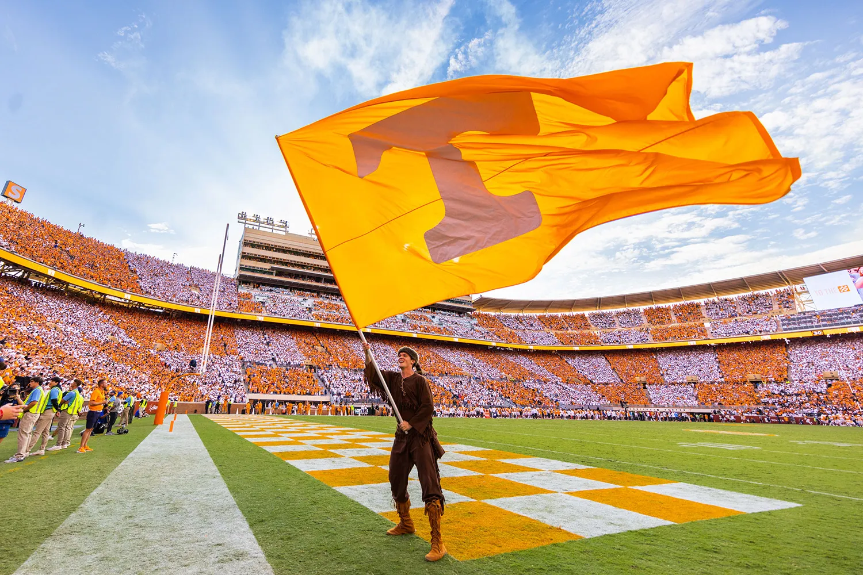
Question & Answer Session

Slide 21
Next Steps / Site Tour
NEYLAND ENTERTAINMENT DISTRICT
Brief intermission (15 minutes), reconvene in LOCATION at 2:30 pm for Site Tour

